Slide 1
Routing Protocols

Slide 2
Router
A router is a device that determines the next network point to which a packet should be forwarded toward its destination
Allow different networks to communicate with each other
A router creates and maintain a table of the available routes and their conditions and uses this information to determine the best route for a given packet.
A packet will travel through a number of network points with routers before arriving at its destination.
There can be multiple routes defined. The route with a lower weight/metric will be tried first.

Slide 3
Routing (IP routing)
Routing Protocol: determines the best path (route) that the packets should follow to arrive to the desired destination
Routing Protocols: A software in the network layer that implements routing algorithms and responsible for:
  Filling and updating routing tables (by finding the shortest paths from each source to each destination) This part is called Routing
  Deciding which output interface an incoming packet should be transmitted on (by referring to the routing table). This part is called Forwarding

Slide 4
Routing Protocols
Static Routing
  Routes change slowly over time
  Shortest paths are pre-computed offline by a special computer running the routing algorithm
  Resulted information is entered manually by the administrator into the routing tables
  Can not update automatically if there is a change in the network or failure
  Used in small networks
Dynamic Routing
  Each router or host learns the state of the network by communicating with its neighbors.
  Based on the collected information, each node can fill its routing table
  More complexity is added to the router
Networks typically use a combination of both static and dynamic routing.

Slide 5
Static Routing
Static routing has several primary uses:
Providing ease of routing table maintenance in smaller networks that are not expected to grow significantly.
Routing to and from a stub network. A network with only one default route out and no knowledge of any remote networks.
Accessing a single default router. This is used to represent a path to any network that does not have a match in the routing table.

Slide 7
Dynamic Routing
The Evolution of Dynamic Routing Protocols
Dynamic routing protocols used in networks since the late 1980s
Newer versions support the communication based on IPv6

Slide 8
Why Dynamic Routing Protocols?
  Each router acts independently, based on information in its router forwarding table
  Dynamic routing protocols allow routers to share information in their router forwarding tables

Slide 9
Purpose of Dynamic Routing Protocols
Routing Protocols are used to facilitate the exchange of routing information between routers.
The purpose of dynamic routing protocols includes:
Discovery of remote networks
Maintaining up-to-date routing information
Choosing the best path to destination networks
Ability to find a new best path if the current path is no longer available

Slide 10
Main components of dynamic routing protocols include:
Data structures - Routing protocols typically use tables or databases for its operations. This information is kept in RAM.
Routing protocol messages - Routing protocols use various types of messages to discover neighboring routers, exchange routing information, and other tasks to learn and maintain accurate information about the network.
Algorithm - Routing protocols use algorithms for facilitating routing information for best path determination.

Slide 12
Dynamic Routing Protocol Operation
In general, the operations of a dynamic routing protocol can be described as follows:
1.The router sends and receives routing messages on its interfaces.
2.The router shares routing messages and routing information with other routers that are using the same routing protocol.
3.Routers exchange routing information to learn about remote networks.
4.When a router detects a topology change the routing protocol can advertise this change to other routers.

Slide 13
How to reduce number of entries in the routing table?
Network-Specific routing (Destination Network IP Address is listed in the table)
Host Specific Routing ( Destination Host IP Address is listed in the table)
Default Routing

Slide 14
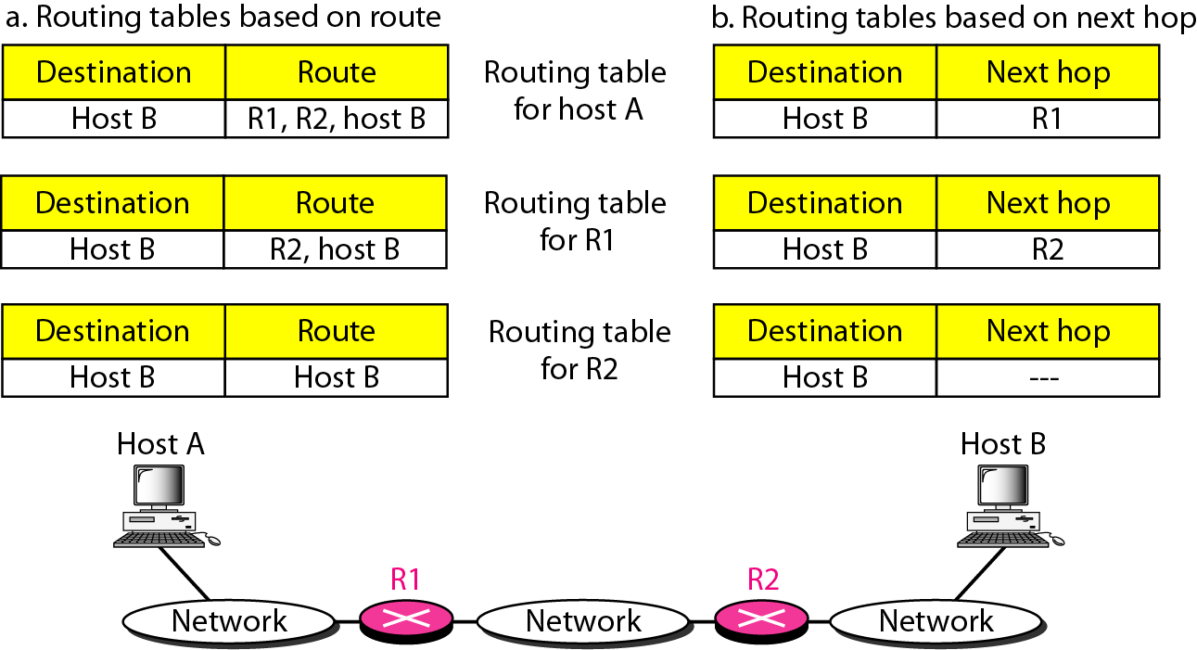
Route method versus next-hop method
In next-hop routing, Routing table holds the information (IP address) that leads to the next hop (router) instead of holding information about the complete path

Slide 15
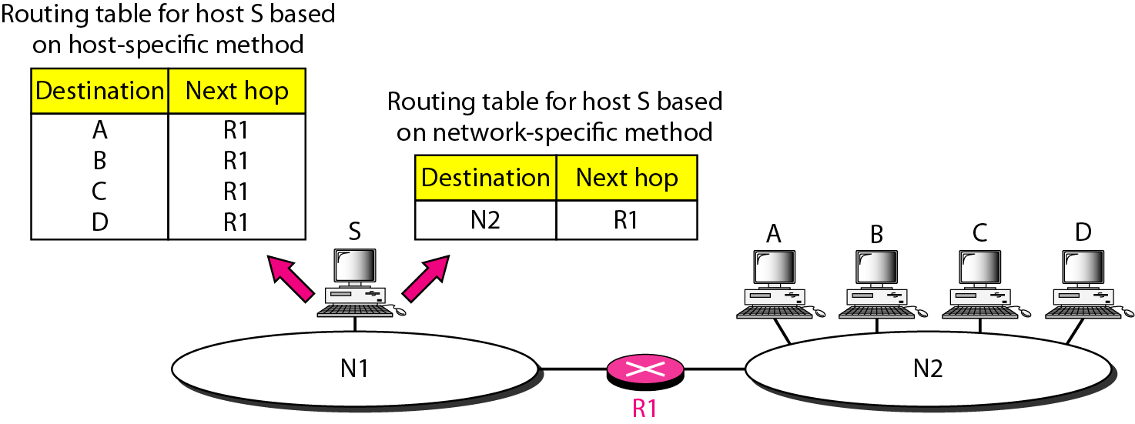
Host-specific versus network-specific method
Instead of having entry for each host connected to the same network, the table contains only a single entry for the address of the network itself

Slide 16
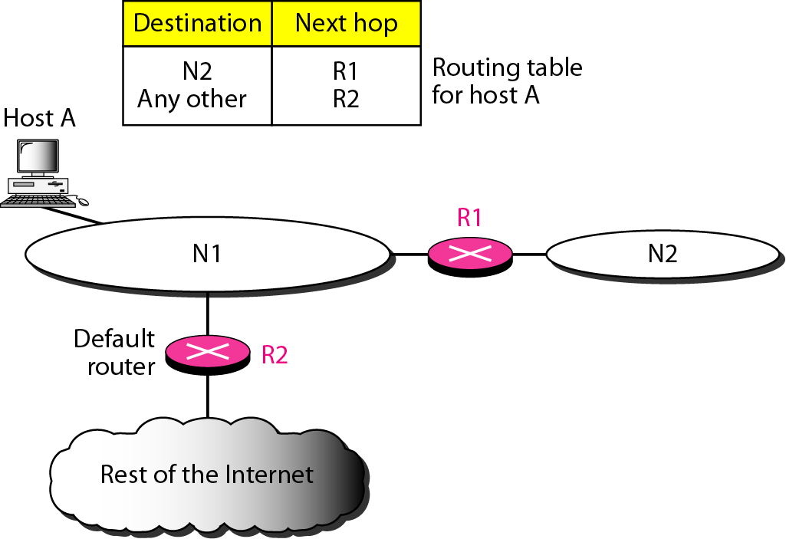
Default method
Default router is used if the destination network address is not found in the routing table

Slide 17
RCC – Routing Control Center

Slide 18
Routing Protocols Classification
  IGP (Interior Gateway Protocol): Route data within an Autonomous System
  RIP (Routing Information Protocol)
  RIP-2 (RIP Version 2)
  IGRP (Interior Gateway Routing Protocol)
  EIGRP (Enhanced Interior Gateway Routing Protocol)
  OSPF (Open Shortest Path First)
  IS-IS (Intermediate System-Intermediate System)
  EGP (Exterior Gateway Protocol): Route data between Autonomous Systems
  BGP (Border Gateway Protocol)

Slide 19
Routing Information Protocol (RIP)
Routing Information Protocol (RIP) is a distance vector protocol that uses hop count as its primary metric.
RIP defines how routers should share information when moving traffic among an interconnected group of local area networks.
Hop Count
Hop count is the number of routers occurring in between the source and destination network.
The path with the lowest hop count is considered as the best route to reach a network and therefore placed in the routing table.

Slide 20
Routing Information protocol (RIP) is the simplest dynamic routing protocol
  Each router broadcasts its entire routing table frequently i.e., Broadcasts go to hosts as well as to routers
  RIP interrupts hosts frequently, slowing them down; Broadcasting makes RIP unsuitable for large networks
RIP is a Distance Vector Protocol
  Learning Routing Information
  Slow Convergence
RIP is Limited
  RIP routing table has a field to indicate the number of router hops to a distant host
  RIP prevents routing loops by limiting number of hops allowed in a path from source and destination. The maximum hop count allowed for RIP is 15 and a hop count of 16 is considered as network unreachable and networks which are far are ignored
  Unsuitable for very large networks

Slide 21
Features of RIP
1. Updates of the network are exchanged periodically.
2. Updates (routing information) are always broadcast.
3. Full routing tables are sent in updates.
4. Routers always trust routing information received from neighbor routers. This is also known as Routing on rumors.

Slide 22
RIP adheres to the following Distance Vector characteristics:
  • RIP sends out periodic routing updates (every 30 seconds)
  • RIP sends out the full routing table every periodic update
  • RIP uses a form of distance as its metric (in this case, hopcount)
  • RIP uses the Bellman-Ford Distance Vector algorithm to determine the best “path” to a particular destination
Other characteristics of RIP include:
  • RIP supports IP and IPX routing.
  • RIP utilizes UDP port 520
  • RIP routes have an administrative distance of 120.
  • RIP has a maximum hopcount of 15 hops.

Slide 23
Any network that is 16 hops away or more is considered unreachable to RIP, thus the maximum diameter of the network is 15 hops. A metric of 16 hops in RIP is considered a poison route or infinity metric.
If multiple paths exist to a particular destination, RIP will load balance between those paths (by default, up to 4) only if the metric (hopcount) is equal. RIP uses a round-robin system of load-balancing between equal metric routes, which can lead to pinhole congestion.
For example, two paths might exist to a particular destination, one going through a 9600 baud link, the other via a T1. If the metric (hopcount) is equal, RIP will load-balance, sending an equal amount of traffic down the 9600 baud link and the T1. This will (obviously) cause the slower link to become congested.

Slide 24
RIP versions:
There are three versions of routing information protocol – RIP Version1, RIP Version2, and RIPng
.
RIP v1 | RIP v2 | RIPng
Sends update as broadcast | Sends update as multicast | Sends update as multicast
Broadcast at 255.255.255.255 | Multicast at 224.0.0.9 | Multicast at FF02::9 (RIPng can only run on IPv6 networks)
Doesn’t support authentication of updated messages | Supports authentication of RIPv2 update messages | –
Classful routing protocol | Classless protocol updated supports classful | Classless updates are sent

Slide 25
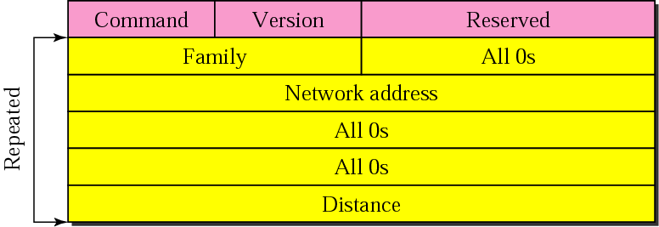
RIP message format
Command: request (1) or response (2)
Version: 1 or 2
Family: TCP/IP has value 2
Network address: address of the destination network
Distance: hop count from the advertising router to the destination
network

Slide 26
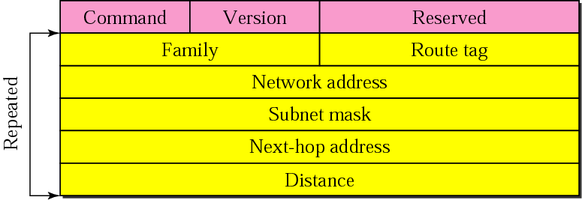
RIP version 2 format
Version 2 supports subnet masks

Slide 27
RIP timers
Timers in RIP help regulate performance. They include the following:
Update timer -- Frequency of routing updates. Every 30 seconds IP RIP sends a complete copy of its routing table, subject to split horizon. (Internetwork packet exchange RIP does this every 60 seconds.)
Invalid timer -- Absence of refreshed content in a routing update. RIP waits 180 seconds to mark a route as invalid and immediately puts it into hold-down.
Hold-down timers and triggered updates -- Assist with stability of routes in a Cisco environment. Hold-downs ensure that regular update messages do not inappropriately cause a routing loop. The router doesn't act on non-superior new information for a certain period of time. RIP's hold-down time is 180 seconds.
Flush timer -- RIP waits an additional 240 seconds after hold-down before it actually removes the route from the table.

Slide 28
Open Shortest Path First (RFC 1247) OSPF
Link-state
has a value in the IP Header (8 bit protocol field)
Interior routing protocol, its domain is also an Autonomous System
(An Autonomous System (AS) is a collection of connected Internet Protocol (IP) routing prefixes under the control of one or more network operators on behalf of a single administrative entity or domain that presents a common, clearly defined routing policy to the internet).
Divides an AS into areas and uses areas to route packets hierarchically within AS

Slide 29
Special routers (autonomous system boundary routers) or backbone routers responsible to dissipate information about other AS into the current system.
Metric based on type of service
  Minimum delay (rtt), maximum throughput, reliability, etc..
Complex
  Link state packet (LSP) databases to be protected
Uses designated routers to reduce number of endpoints

Slide 30
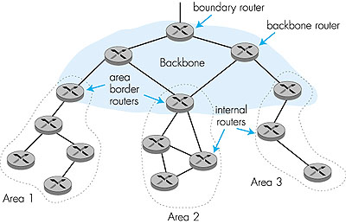
OSPF AS organized into a 2-level hierarchy
Within each area, border router
responsible for routing outside
the area
(ASBR)
Exactly one area
is backbone area
Backbone area contains all area border routers and possibly others

Slide 31
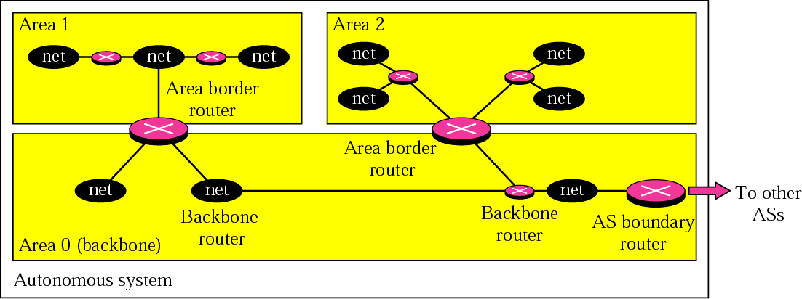

Slide 32
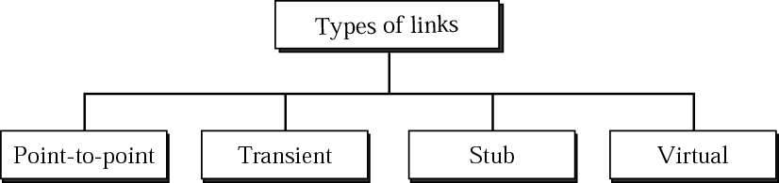
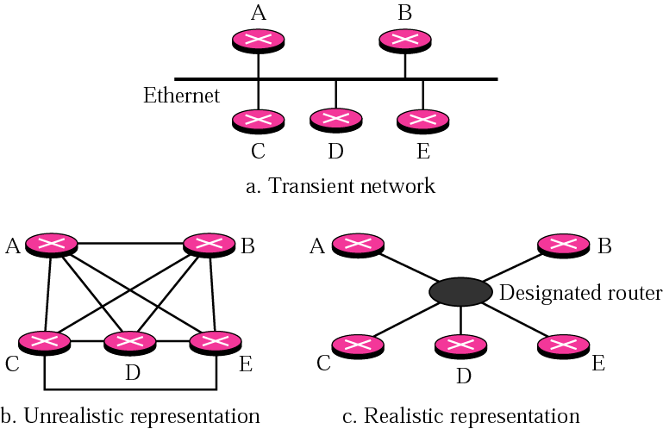
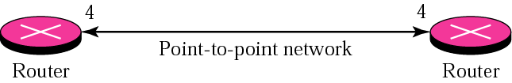
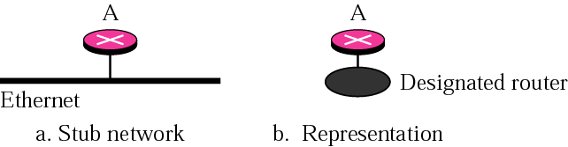
OSPF (type of links)

Slide 33
Point-to-Point Link: A link between two routers with no hosts or intermediate routers between them.
Transient Link: This occurs when many routers are attached to a single network, such as a LAN or Wi-Fi.
Stub Network: A network connected to the OSPF domain through a single router. All data packets sent or received go through this single router.
Virtual Link: When a direct link is broken or not possible, a virtual link can be configured by the network administrator to connect two routers indirectly.

Slide 34
Five types of OSPF packets
  Hello
  Database description
  Link-State Request/Update/Acknowledgement

Slide 35
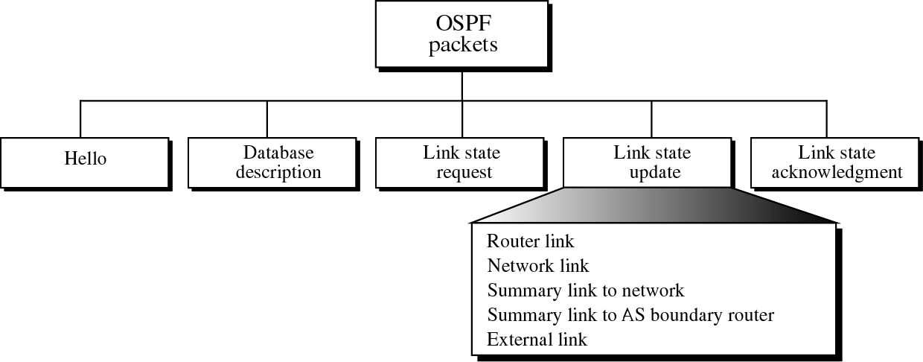
Responds to a link-state request packet. These messages also are used for the regular dispersal of LSAs. Several LSAs can be included within a single link-state update packet.
Type 1
2
3
4
5
When a router just came up, it cannot wait for all link state packets. Neighbors will send it a database description (not the full database but like an outline). From this, the router can then ask for information it does not have.
Establishes and maintains neighbor relationships.
Requests pieces of the topological database from neighbor routers. These messages are exchanged after a router discovers (by examining database-description packets) that parts of its topological database are out of date.
Ack-nowledges link-state update packets.

Slide 36
OSPF common header
Area Identification

Slide 37
All OSPF packets share the same header
Version: 8-bit
  The version of the OSPF protocol.
Type: 8-bit
  The type of the packet
Message length: 16-bit
  The length of the total message including the header
Source route IP address: 32-bit
  The IP address of the router that sends the packet

Slide 38
Area identification: 32-bit
  The area within which the routing take place
Checksum: 16-bit
  Error detection on the entire packet excluding the authentication type and authentication data field
Authentication type: 16-bit
  Define the authentication method used in this area 0: none, 1: password
Authentication: 64-bit
  The actual value of the authentication data
  Filled with 0 if type = 0; eight-character password if type = 1

Slide 39
Link state updates
Each Link State Update packet carries a set of new link state advertisements (LSAs) one hop further away from their point of origination.
A single Link State Update packet may contain the LSAs of several routers.
Each LSA is tagged with the ID of the originating router and a checksum of its link state contents.

Slide 40
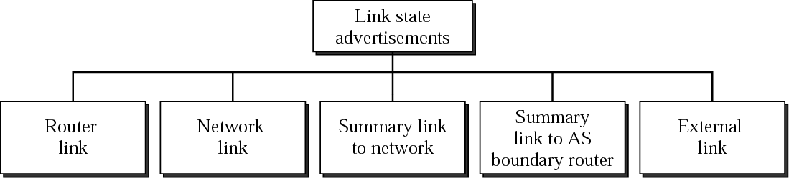
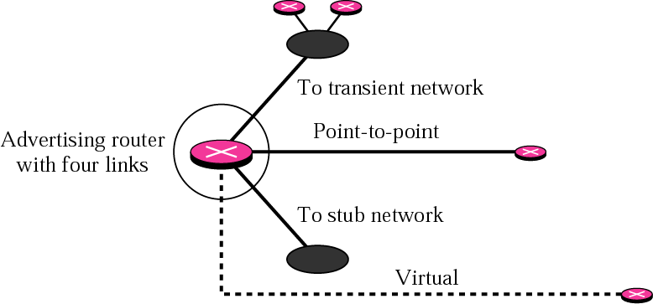
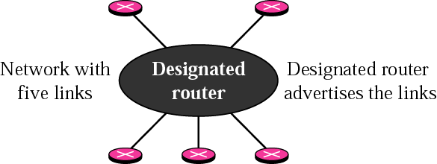
OSPF (link state advertisement)
Network Link
Router Link

Slide 41
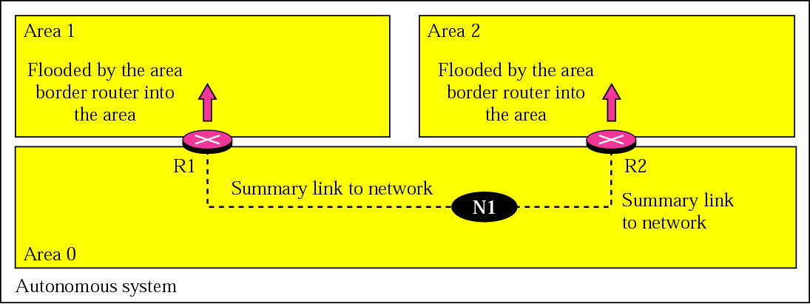
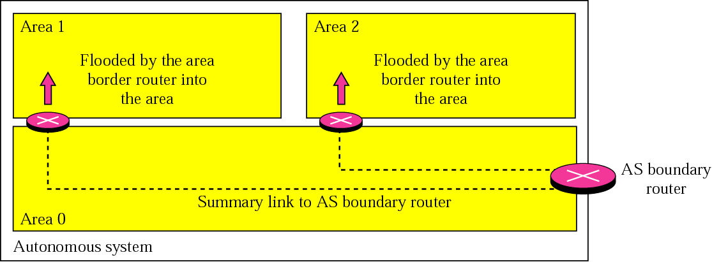
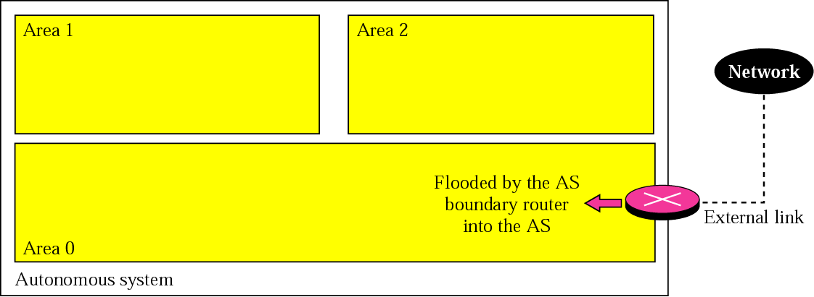
OSPF (LSA cont.)
Summary link to Network
Summary link to AS boundary router
External Link

Slide 42
OSPF operations
Hello protocol
Database synchronization
Propagation of link-state information
Building of routing table

Slide 43
Hello Protocol
Hello packets are transmitted to all interfaces periodically
Discover neighbors, establish and maintain neighbor adjacency relationships
Elect Designated Router (DR) if there are multiple routers in a broadcast network

Slide 44
Database synchronization
Two neighboring routers exchange database description packets to synchronize their link-state databases.
Database description includes only a list of LSA headers. New or more up-to-date LSAs will be requested later
Packets sent by master are acknowledged by slave

Slide 45
Propagation of link-state information
Link-state request sent
  When a router wants to update parts of its link-state database
Link-state update sent
  When a link state is requested, or
  When a link-state changes, or
  Periodically
Link-state acknowledgement sent in response to a link-state update
  Link-state updates retransmitted periodically until acknowledged

Slide 46
Flooding LSAs
A node receiving a link-state update selectively first installs each LSA in the update into its LSA database
Then it decides on which of its other links to flood the LSA
  it may decide not to flood an LSA out a particular interface if there is a high probability that the attached neighbors have already received the LSA.

Slide 47
Building of routing table
Router S has knowledge of the entire area topology (complete link-state database)
Some algorithm such as Dijkstra’s is used to generate shortest path tree, rooted at router S
Only the next hop will be used in the routing table

Slide 48
Border Gateway Protocol (RFC 1771)
Why the distance vector routing and link state routing are not good candidates for inter autonomous system routing?
Distance vector routing
Not preferred for inter-AS routing (exterior routing protocol)
  Assumes all routers have a common distance metrics to judge route preferences.
    If routers have different meanings of a metric, it may not be possible to create stable, loop free routes.
  A given AS may have different priorities from another AS.
  Gives no information about the ASs that will be visited.
There are occasions in which the route with the smallest hop count is not the preferred route
For example, we may not want a packet to pass through an AS that is not secure even it is the shortest path
Unstable

Slide 49
Link state routing
An internet is usually too big for this routing method
Link-state routing protocol
  Different metrics.
  Flooding is not realistic.
  If used, each router must have a huge link state database
It would take a long time for each router to calculate its routing table by Dijkstra algorithm

Slide 50
BGP
An inter-autonomous system routing protocol
Based on the path vector routing method
Path vector routing
  No metrics,
  Information about which networks can be reached by a given router and ASs to be crossed.
  distance vector annotated with entire path
  also with policy attributes
  guaranteed loop-free
Differs from DVA
  Path vector approach does not include a distance or cost estimate
  Lists all of the ASs visited to reach destination network.
Can use non-tree backbone topologies
Uses TCP to disseminate DVs
  reliable
  but subject to TCP flow control
Policies are complex to set up

Slide 51
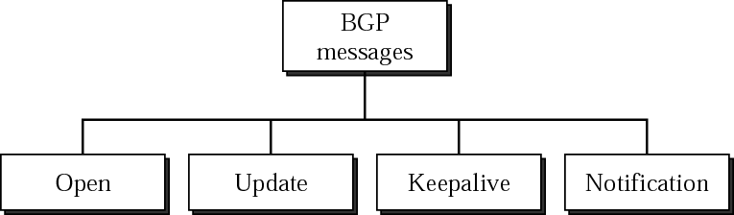
BGP Messages
Messages are sent over TCP connections on port 179.
Functional procedures
  Neighbor acquisition (open message, acceptance through Keepalive message)
  Neighbor reachability (periodic Keepalive messages)
  Network reachability (broadcast an update message)
    Each routers maintains a database of networks that can be reached
    + preferred route to this network.
RFC does not address
    How a router knows the address of another router.
    Up to network admin.

